Slide 1
How to Migrate to VMware
for Hyper-V administrators

Slide 2
1
Introductions
2
vSphere Architecture
Agenda
3
Key Differences
4
Management Tools
5
Management Tool Demos
6
vSphere Converter Standalone
7
Q & A and Wrap-Up

Slide 3
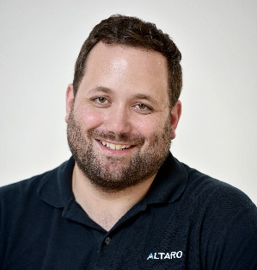
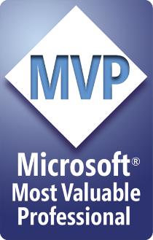


About your host: Andy Syrewicze
Technical Evangelist & Microsoft Cloud and Datacenter Management (Hyper-V) MVP
Technical Evangelist for Altaro Software
14+ Years providing technology solutions across several industry verticals
Main focus: Virtualization, Cloud Services and the Microsoft Server Stack, with an emphasis on Hyper-V and VMware
@asyrewicze
www.altaro.com/hyper-v/
www.altaro.com/vmware/
Notes:
Technical Evangelist for Altaro Software, providing community support, technical marketing and pre-sales expertise.
Prior to that I spent the last 14+ years providing technology solutions across several industry verticals including, education, fortune 500 manufacturing, healthcare and professional services working for MSPs and Internal IT Departments.
My focus has been in Virtualization, Cloud Services and the Microsoft Server Stack, with an emphasis on Hyper-V & VMware and interacting with the IT community via blogs, social media and published writings.

Slide 4


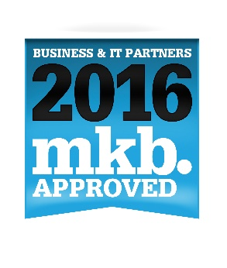
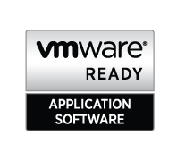


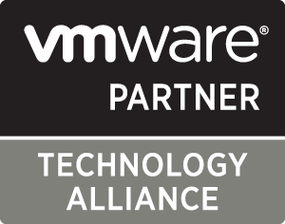
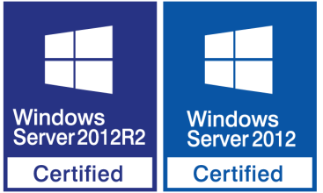
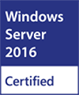
About Altaro Software
Altaro is a fast-growing developer of user-friendly backup solutions for small and mid-market businesses.
Virtual Backup trusted by 30,000+ Customers and 6,000+ Partners and MSPs worldwide.
Flagship product: Altaro VM Backup – altaro.com/vm-backup

Slide 5
Let’s set some expectations first…..

Slide 6
Crash Course on VMware

Slide 7
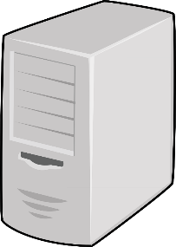
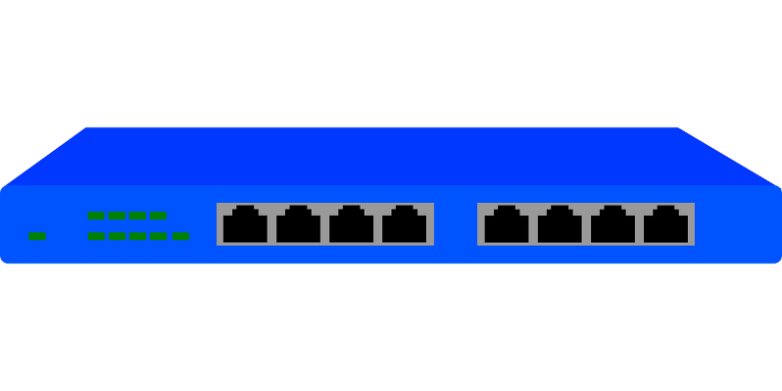
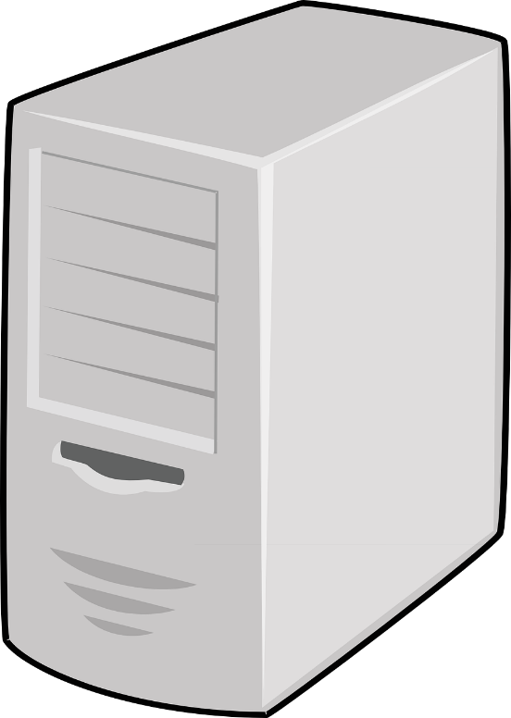
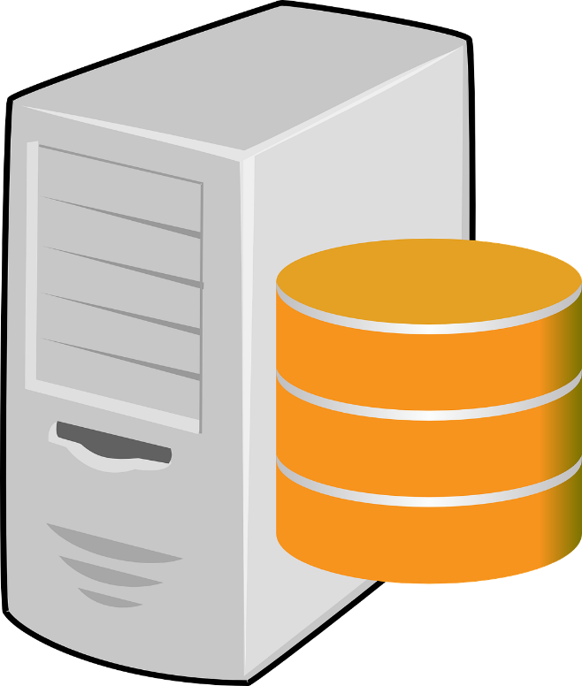
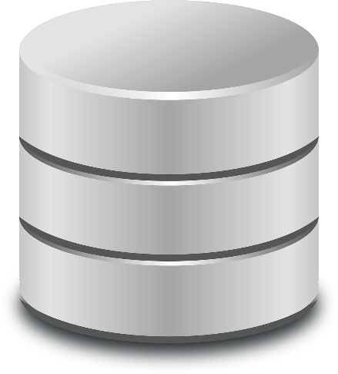
VMware Architecture
vCenter
Cluster/VM Traffic
Cluster/VM Traffic
VM Traffic
I/O Traffic
I/O Traffic
ESXi Host
ESXi Host

Slide 8
VMware Licensing Tiers
Windows Licensing Information
The needed level will depend on your needs
You still have to license you Windows VMs
vSphere Essentials Kit
  Best for Small Installations max of three 2-CPU Hosts
  Includes all the common stuff, vMotion, HA….etc..etc.
vSphere Standard
  Common Entry point for organizations with 4+ Hosts
  Includes things like Storage vMotion, Fault Tolerance, and VVols
vSphere Enterprise Plus
  Intended for larger organizations
  Includes things like container services, OpenStack, VM Encryption, DRS
Standard Edition
  Complete Windows Server
  Allows you to run 2 OSEs
Datacenter Edition
  Complete Windows Server
  Allows you to run unlimited OSEs.

Slide 9
Key Differences From Hyper-V
Commonly Asked ESXi Config Maximums
vCenter is Needed for Clustering!
Hardware support while good, is more strict than Hyper-V. Be sure to reference the VMware HCL at: https://www.vmware.com/resources/compatibility/search.php?form=OPRTSD&pc=OPER
Management is nearly 100% web based via flash or HTML 5
Some features are at a cluster level as opposed to a per VM level, such as HA.
You are unable to install anything on the host directly
128 vCPUs per VM
6TB of memory per VM
62TB VMDK Capacity
1024 VMs per Host
64 Physical Nodes Per Cluster

Slide 10
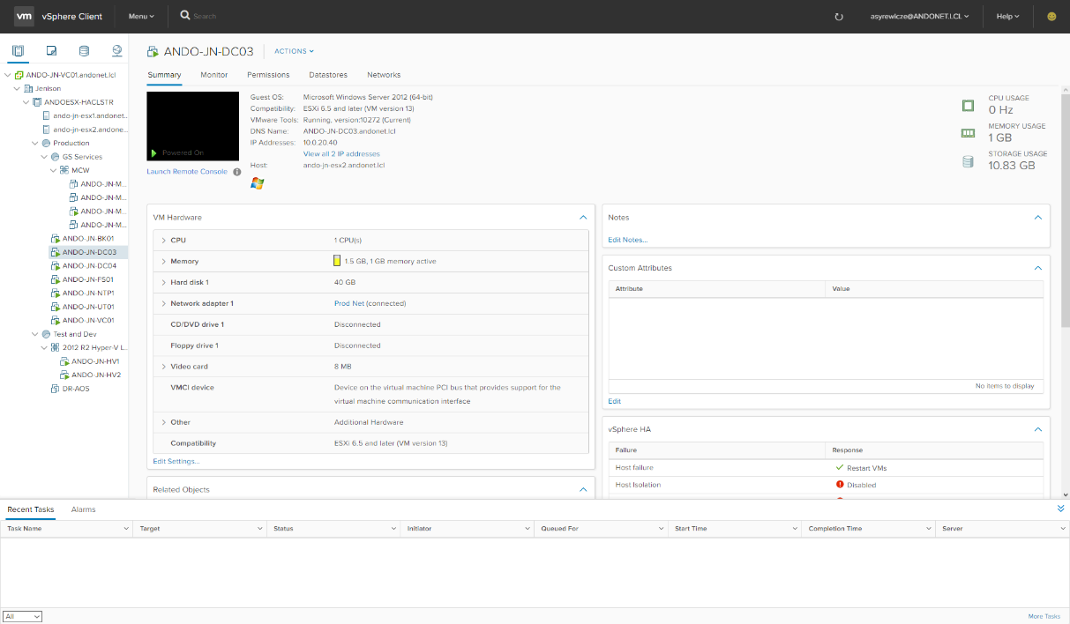
Managing VMware
It’s a bit different than Hyper-V, and a bit easier…
3 Different Management Tools Possible
vSphere Host Client for Single Stand Alone Hosts
vCenter for vSphere Clusters of all sizes
PowerCLI – A VMware PowerShell Module
Can be Managed by SCVMM for multi-hypervisor deployments.

Slide 11
Demo: Management Tools for vSphere

Slide 12
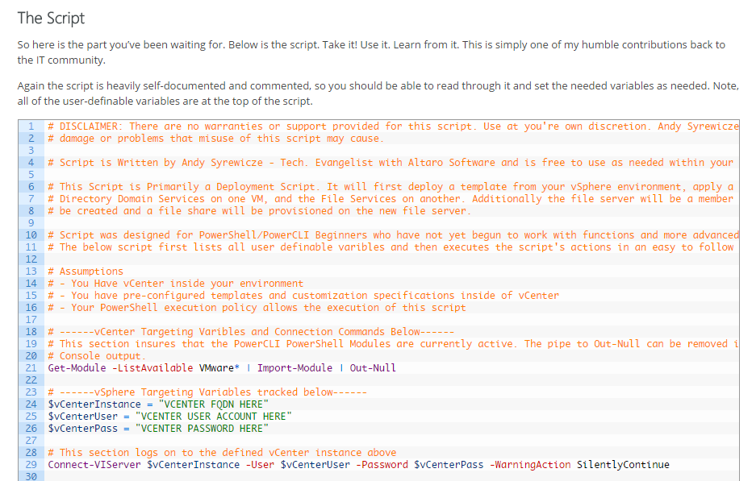
Interested in more PowerCLI Goodness?
Take this! It’s Dangerous to go alone!
Script shows you how to use PowerCLI and vSphere to deploy entire workloads
Designed for beginners with very sequential coding
Heavily Documented to help you understand what is happening in each section
Learn more below
http://www.altaro.com/vmware/powercli-script-deploy-vms-and-configure-the-guest-os/

Slide 13
Migration Utilities for VMware

Slide 14
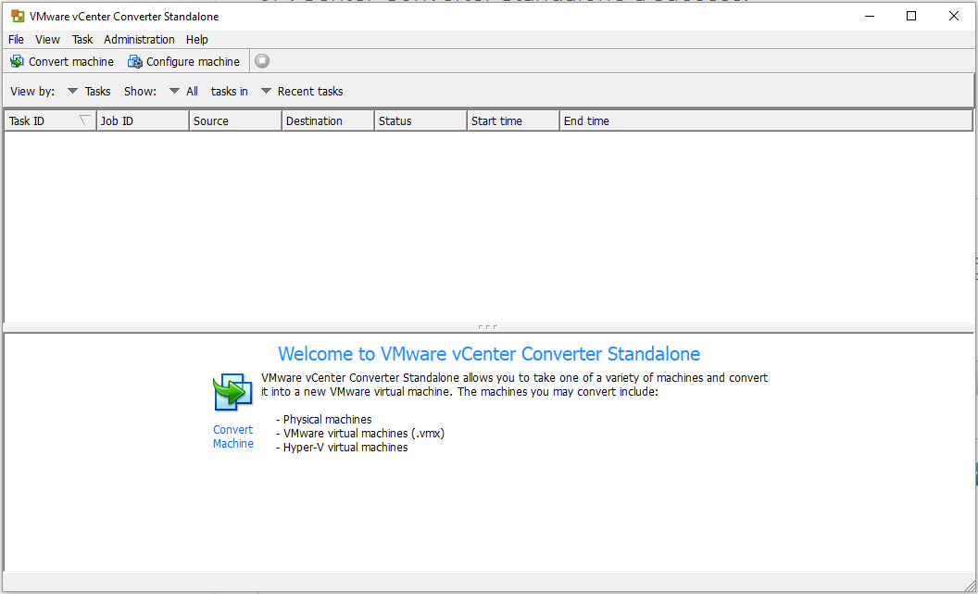
VMware vSphere Converter Standalone
Great Tool Provided by VMware for Conversions
Free to download and use
Utility can be used for the vast majority of conversion tasks
Can be run on the local machine, or against a remote machine
Can be setup in a client-server-agent fashion for more complex conversion jobs
Will automatically convert the machine directly into a VMware VM on a running ESXi host.
https://my.vmware.com/web/vmware/evalcenter?p=converter

Slide 15
Alternatives
vSphere Converter Standalone works in the vast majority of cases, but if you need more….
3rd Party Conversion Utilities
If the workload is easily movable (such as AD), consider just migrating the workload.
If file based, consider scripted copy jobs and/or distributed filesystems and replication.

Slide 16
Demo: vSphere Converter Standalone

Slide 17
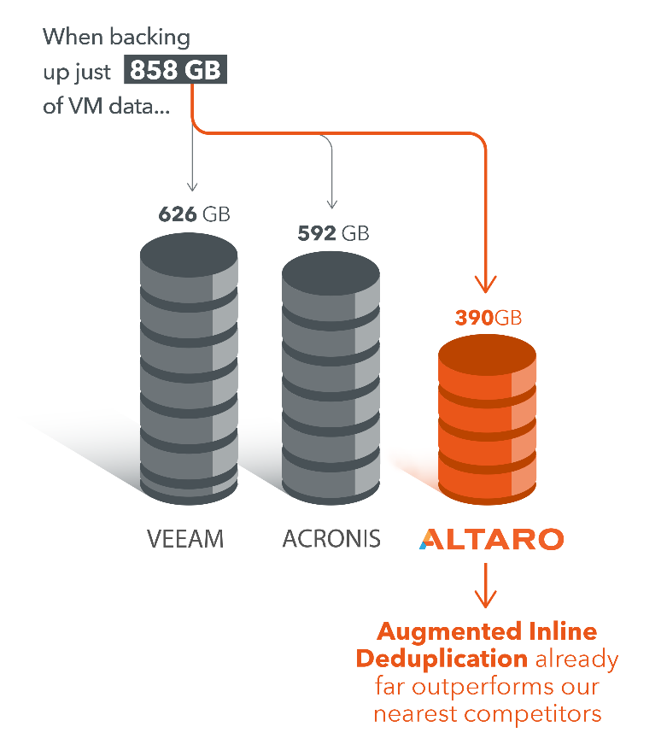
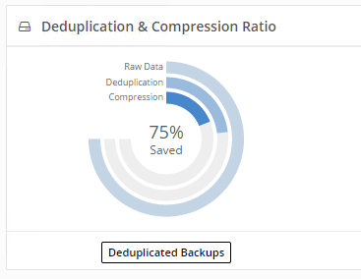
Altaro VM Backup v7.1
Virtual backup trusted by 30,000+ SMBs and 6,000+ IT Resellers and MSPs
Efficient backup setup – Easy & quick to setup and use
Full control of your backups – Powerful, flexible and easy to scale
Praise-winning Support
Best storage savings in the industry
For more info & 30-day trial: altaro.com/vm-backup

Slide 18
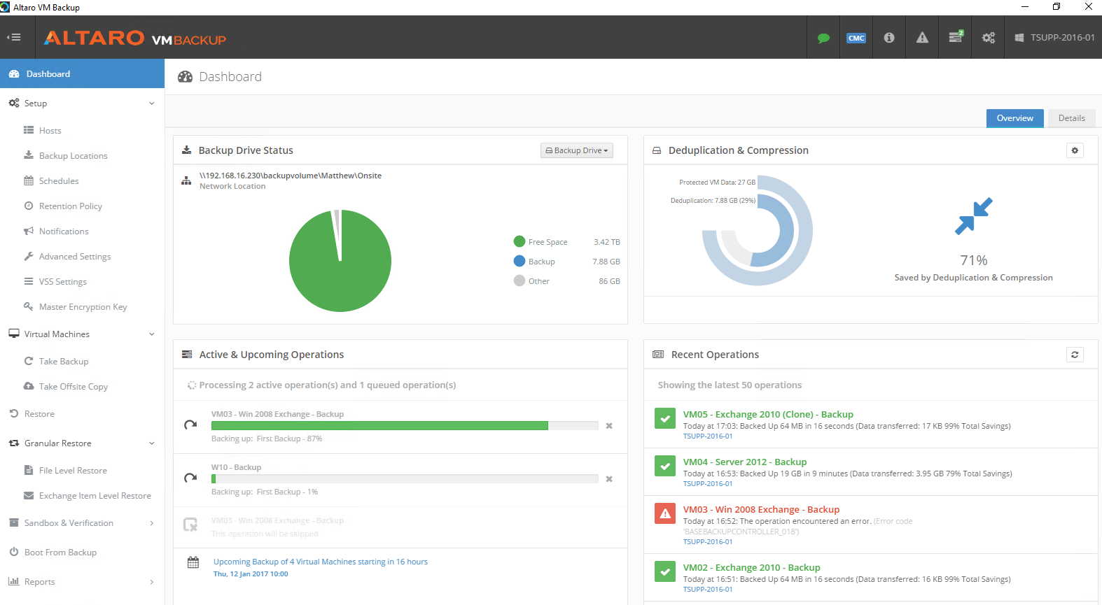
Altaro VM Backup v7.1 – Quick demo
Virtual backup trusted by 30,000+ SMBs and 6,000+ IT Resellers and MSPs
For more info & 30-day trial: altaro.com/vm-backup

Slide 19
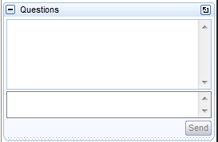
LIVE Q&A!
Your turn: Time to answer your questions!
What questions do you have on today’s topic? Type your questions in the “Questions” box in GoToWebinar
Reminder
  Any questions we can’t tackle today will be answered in an upcoming blog post on our Hyper-V blog: www.altaro.com/hyper-v/
  Want to be notified when that’s published? Sign up for email updates here: www.altaro.com/hyper-v/sign-up/

Slide 20
Thank you for attending!

