Slide 1
Migrating to Hyper-V
For VMware Administrators

Slide 2
1
Introductions
2
Hyper-V Architecture
Agenda
3
Management Differences
4
Disk2VHD and MVMC
5
Azure Site Recovery
6
Other Options?
7
Q & A and Wrap-Up

Slide 3
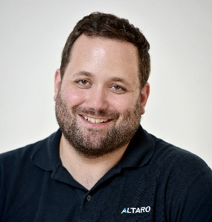
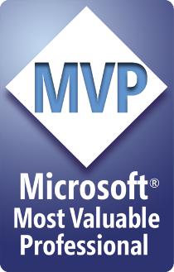
Andy Syrewicze
Technical Evangelist & Microsoft Cloud and Datacenter Management (Hyper-V) MVP
Technical Evangelist for Altaro Software, providing community support, technical marketing and pre-sales expertise.
Prior to that I spent the last 14+ years providing technology solutions across several industry verticals including, education, fortune 500 manufacturing, healthcare and professional services working for MSPs and Internal IT Departments.
My focus has been in Virtualization, Cloud Services and the Microsoft Server Stack, with an emphasis on Hyper-V and interacting with the IT community via blogs, social media and published writings.
Twitter - @asyrewicze
Blog – http://www.altaro.com/hyper-v

Slide 4
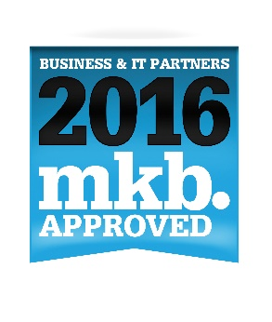


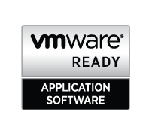
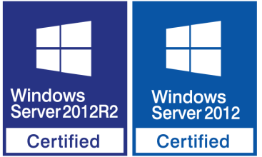
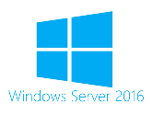
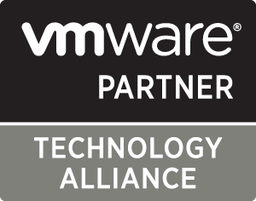


About Altaro Software
Altaro is a fast-growing developer of user-
friendly backup solutions for small
and mid-market businesses.
Virtual Backup trusted by 30,000+ Customers
and 6,000+ Partners and MSPs
Flagship product: Altaro VM Backup
    altaro.com/vm-backup

Slide 5
Let’s set some expectations first…..

Slide 6
Crash Course on Hyper-V

Slide 7
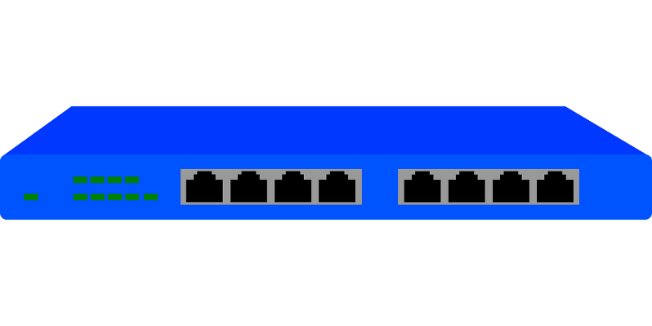
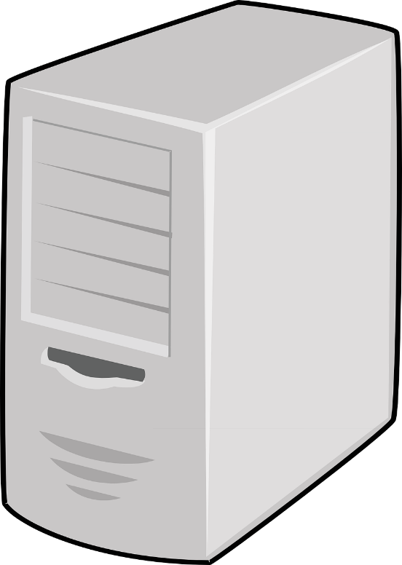
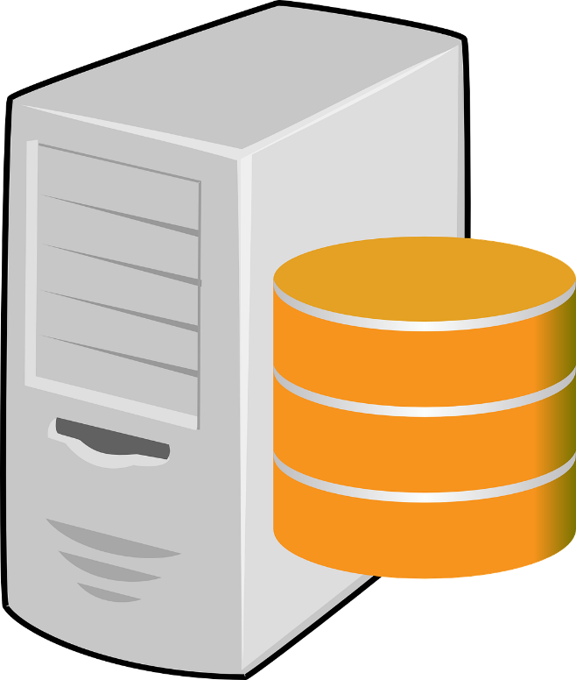
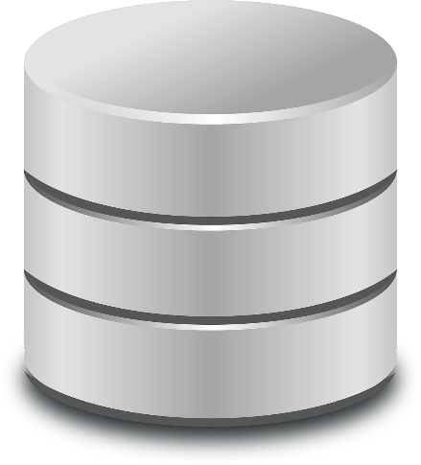
Hyper-V Architecture
Cluster/VM Traffic
Cluster/VM Traffic
VM Traffic
I/O Traffic
I/O Traffic
Hyper-V Host
Hyper-V Host

Slide 8
Windows Edition Options
Operating System Options
You can choose any edition of Windows
What mode will you run the OS in?
Hyper-V Server
  Free SKU of Windows Server the contains only the roles needed for Hyper-V
  Most similar to ESXi
  No Licensing included
Standard Edition
  Complete Windows Server
  Allows you to run 2 OSEs
Datacenter Edition
  Complete Windows Server
  Allows you to run unlimited OSEs.
Full Server with GUI
  Best for Small Installations with no remote mgmt. options
  Management tools available right on the host
Server Core
  Considered to be best balance between low overhead and management
  PowerShell and basic tools available on the host itself.
Nano Server
  Completely Headless Installation
  Lowest Overhead and most secure
  100% remote management

Slide 9
A Couple of Common Hyper-V Myths
Mythbusting 101
Myth
Vs.
Fact
You Need SCVMM if you want Clustering and HA
You Can’t create “templates” without SCVMM
Hyper-V isn’t as secure as ESXi, because it’s Windows
A Physical Domain Controller is required for Clustering
Hyper-V Doesn’t Scale as High as VMware
240 vCPUs per VM
12TB of memory per VM
64TB VHDX Capacity
1024 VMs per Host
64 Physical Nodes Per Cluster

Slide 10
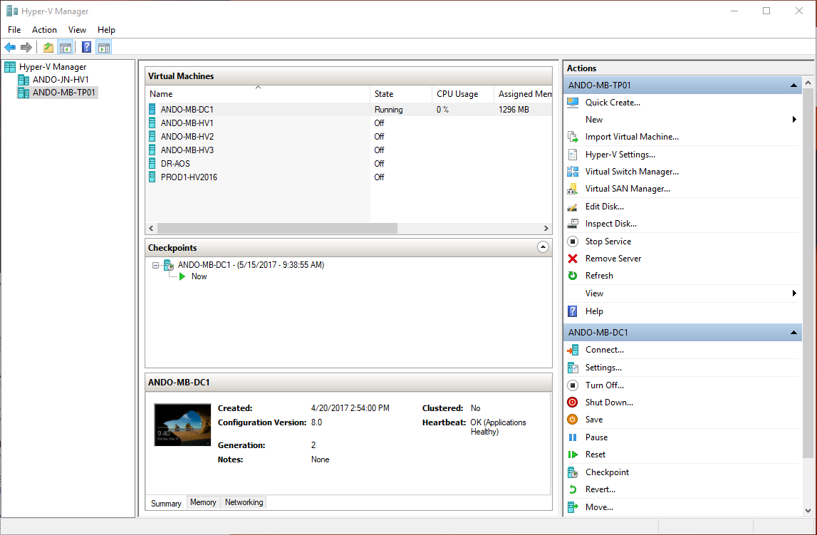
Managing Hyper-V
It’s a bit different than vSphere
Up to 4 Potential Management interfaces depending on your environment/use-case.
Hyper-V Manager for small 1 to 2 host setups without clustering
Failover Cluster Manager for Small to Medium Sized Clusters
System Center Virtual Machine Manager (SCVMM) for large enterprise clusters
PowerShell for all Automation Workloads

Slide 11
Demo: Management Tools for Hyper-V

Slide 12
Migration Utilities for Hyper-V

Slide 13
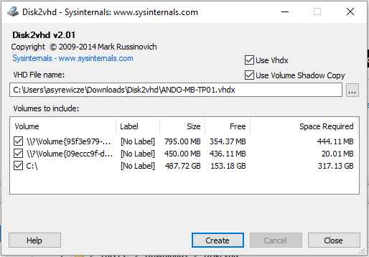
Disk2VHD
By SysInternals
Free to download and use
Basic utility for conversion of a running system to VHD(X) format
Run it on the target system
Provides very basic CLI functions for basic scripting functionality
Once converted you create a new VM, and attach the created VHD(X).
https://technet.Microsoft.com/en-us/sysinternals

Slide 14
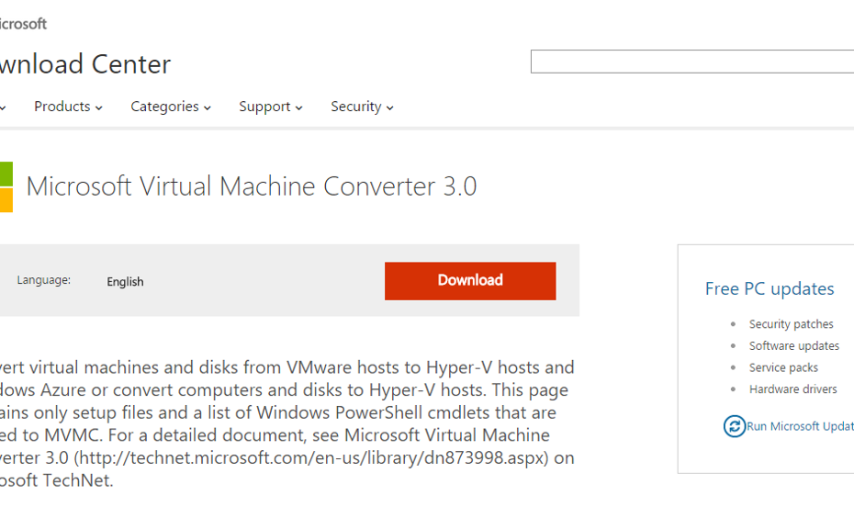
Microsoft Virtual Machine Converter
Had potential, but now deprecated….
Still available until Mid-June
Supports vCenter/ESXi 4.1, 5.1, 5.5 as Source
Supports VM Hardware Version 4,7,8,9, and 10
Destination can be Hyper-V 2008 R2 though 2012 R2 or an Azure VHD
Guest OS can be WinServer 2008 – 2012R2, Vista – Win 8.1, RHEL/CENTOS 5/6, Ubuntu 12.04, SLES 11, Debian 7
Online Conversions required disabled firewall, RDP enabled, and proper permissions
Linux conversions require SSH installed, and Root Credentials (sudo not supported!)
http://bit.ly/1HbRIg7

Slide 15
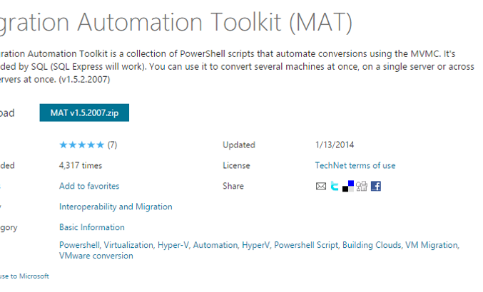
Migration Automation Toolkit
Had potential, but now deprecated….
Collection of Automation Scripts for MVMC
Backed by SQL Express for Mass Conversion Jobs
Scalable to allow several conversions occurring at once
PowerCLI 5.1 minimum required
http://bit.ly/1HdU0eW

Slide 16
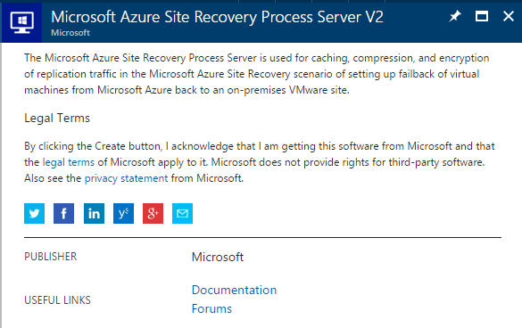
Azure Site Recovery
Works…. But there are some caveats…
The new “preferred” method for migrating VMs to Hyper-V…. However…
Process involves syncing over the WAN to Azure, and then downloading the VHD to your local network.
Massive Hardware Requirements
  Dedicated Server Onsite with 16GB memory, 8 CPU Cores, and 1.2 TB (Yes Terabytes) of Storage Recommended.
  Process Server Required in Azure
No Cost for having the converted VM in Azure for the first 31 days.
https://azure.Microsoft.com/en-us/services/site-recovery/

Slide 17
Alternatives
The mentioned tools aren’t a fit for everyone so….
System Center Virtual Machine Manager (SCVMM)
3rd Party Conversion Utilities (Microsoft Software Partners)
If the workload is easily movable, consider just migrating the workload.

Slide 18
Altaro VM Backup v7.0
Virtual backup trusted by 30,000+ SMBs and 6,000+ IT Resellers and MSPs
Efficient backup setup
  Up and running quickly, without the need for complex configurations
  Easy to use, intuitive UI
Full control of your backups
  Manage and monitor backups across all your VMware and Hyper-V hosts
  from a single pane of glass - Scales easily!
  Augmented Inline Deduplication
Praise winning support, which comes as part of the package – Experts in VMware and Hyper-V who are quick to respond and resolve.
Built specifically for small- and mid-market businesses
Notes:
COST
Reboots impact my business.
When a reboot is required, the systems need to be back in service ASAP.
Large server images take too long to configure and install.
Large images take a long time to install and configure.
Transferring images consumes too much network bandwidth.
Storing images requires too much disk space.
SECURITY
Shrink the surface to help prevent attacks.
I need an OS without as many vulnerabilities.
DENSITY
Infrastructure requires too many resources.
If the OS consumes fewer resources, I can increase my VM density.
Higher VM density lowers my costs and increases my efficiency & margins.

Slide 19
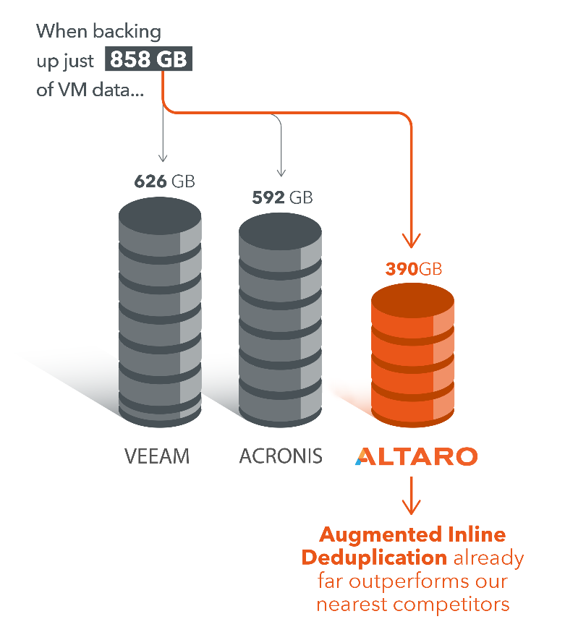
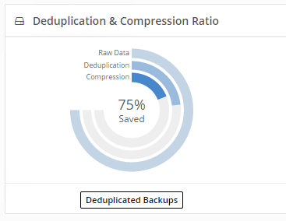
Augmented Inline Deduplication
Augmented Inline Deduplication ensures that common data is only transferred to the backup or offsite location ONCE, without the need for Post-Process Deduplication!
The best Deduplication available on the market!
  Significantly lower storage requirements
  Much faster backups and not taxing on
  server performance
  Less data transferred, thus loads of
  bandwidth saved (and efficiency
  increases the more VMs you back up)
Notes:
COST
Reboots impact my business.
When a reboot is required, the systems need to be back in service ASAP.
Large server images take too long to configure and install.
Large images take a long time to install and configure.
Transferring images consumes too much network bandwidth.
Storing images requires too much disk space.
SECURITY
Shrink the surface to help prevent attacks.
I need an OS without as many vulnerabilities.
DENSITY
Infrastructure requires too many resources.
If the OS consumes fewer resources, I can increase my VM density.
Higher VM density lowers my costs and increases my efficiency & margins.

Slide 20
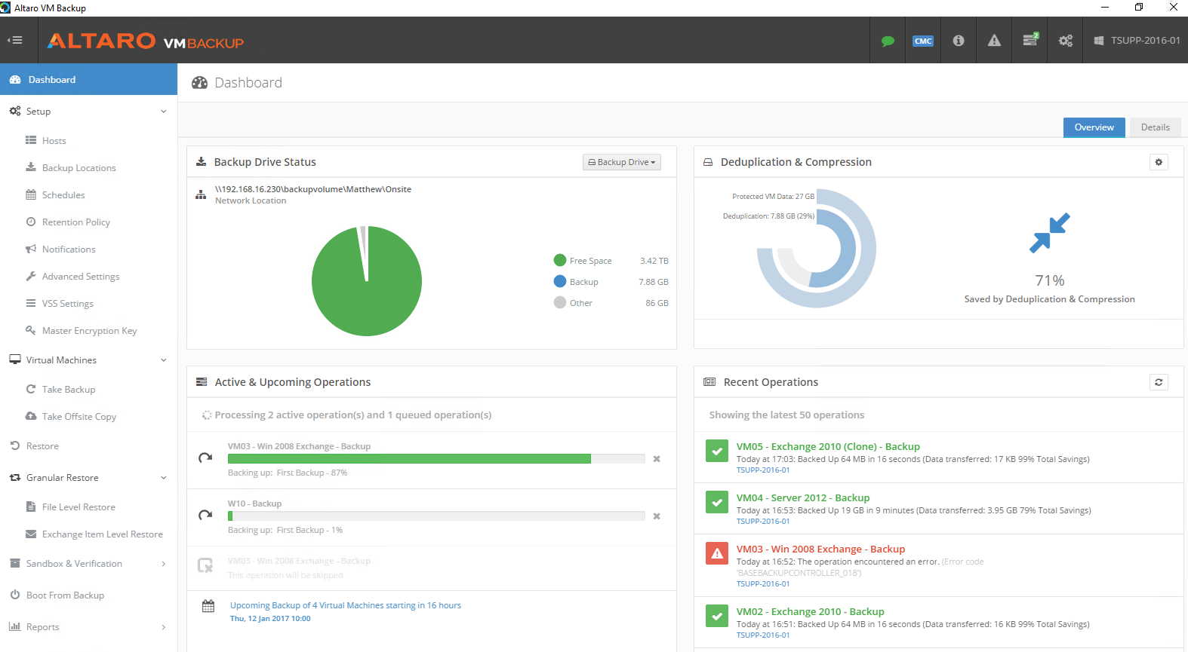
Altaro VM Backup v7.0
More info here: altaro.com/vm-backup
Download your copy here: altaro.com/download
Notes:
COST
Reboots impact my business.
When a reboot is required, the systems need to be back in service ASAP.
Large server images take too long to configure and install.
Large images take a long time to install and configure.
Transferring images consumes too much network bandwidth.
Storing images requires too much disk space.
SECURITY
Shrink the surface to help prevent attacks.
I need an OS without as many vulnerabilities.
DENSITY
Infrastructure requires too many resources.
If the OS consumes fewer resources, I can increase my VM density.
Higher VM density lowers my costs and increases my efficiency & margins.

Slide 21
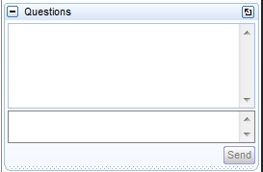
Time for our live Q&A!
You can type your questions in the “Questions” section of the GoToWebinar UI if you haven’t already!
Reminder: Any questions we can’t tackle today will be posted with their
answers along with the webinar recording in the next week
or two at: http://www.altaro.com/vmware
Reminder: You can also sign up to be notified when the follow-up post is ready at: http://www.altaro.com/vmware/sign-up/
Notes:
COST
Reboots impact my business.
When a reboot is required, the systems need to be back in service ASAP.
Large server images take too long to configure and install.
Large images take a long time to install and configure.
Transferring images consumes too much network bandwidth.
Storing images requires too much disk space.
SECURITY
Shrink the surface to help prevent attacks.
I need an OS without as many vulnerabilities.
DENSITY
Infrastructure requires too many resources.
If the OS consumes fewer resources, I can increase my VM density.
Higher VM density lowers my costs and increases my efficiency & margins.

Slide 22
Thank you for Attending!

